Slide 1
Public Private Partnership in Police Administration : Need of the Hour
Dr. Kalpeshkumar L Gupta
Mr. Mradul Mishra
Assistant Professor - Research
Gujarat National Law University, Gandhinagar
Joint National Seminar on
Police Structuring – Enhancing Lean and Effective Institution
Organized by
Gujarat National Law University &
National Security Advisory Board, Govt. of India
August 21, 2018

Slide 2
Outline
Introduction
About PPP
PPP in Police Administration
Suggested Partnership
Concluding Remarks

Slide 3
1. Introduction
As per the latest available data from Ministry of Finance, 1,539 PPP projects have been awarded so far in India.
Out of these, about 50% are currently in operational stage, while others are either scrapped or are under different stages of implementation.
Sector-wise break-up shows that transport sector accounts for 58% of the these projects, followed by energy sector with 24%, while social and commercial infrastructure sector accounts for 9% and water & sanitation for the balance 8%.
http://niti.gov.in/content/rebooting-public-private-partnership-india

Slide 4
2. About PPP
A mature PPP framework, along with a robust enabling ecosystem shall enable the Government to accomplish, to a considerable extent, what our Prime Minister, Shri. Narendra Modi has said “The Government has no business to do business” and thereby promote private sector investments and participation towards the nation building.
http://niti.gov.in/content/rebooting-public-private-partnership-india

Slide 5
3. PPP in Police Administration
Lincolnshire Police (UK)
Control room, crime files management,
property mgt, monitoring of offenders
Frederik Police Department
Partnership with universities and colleges
Hong Kong Police
Partnership with private mobile agencies
PPP in traffic enforcement
In UK, Italy, Belgium, Spain

Slide 6
3. PPP in Police Administration
USA: under PPP model, USA has created the Overseas Security Advisory Council (OSAC) to promote security concepts and enhance co-operation between the US Department of State and US Organizations operating worldwide.
UK: While applying PPP model, UK has established the Security Information Service for Business Overseas (SISBO) which assists businesses by providing information on security and risks which they may face when operating in any particular market overseas.

Slide 7
3. PPP in Police Administration
World Economic Forum in its report released in January 2016* recommended PPP model to be used against cybercrime. The recommendations mainly focus on following points:
Public and private sectors should share more information related to cyber threats, vulnerability and consequences.
Public and private sectors should work to create new platforms, strengthen existing platforms, and coordinate these platforms to increase information-sharing and improve investigations and prosecutions.
Public and private sectors should cooperate to encourage and advance wider adoption of the Budapest Convention on Cybercrime, or, of the principles it promotes.
Public and private sectors should work to build trust and discuss contentious topics related to cybercrime, such as encryption, cloud servers, data access and protection of privacy, to find appropriate solutions.
Public and private sectors can engage in other initiatives aimed at reducing cybercrime.
*http://www3.weforum.org/docs/WEF_Cybercrime_Principles.pdf

Slide 8
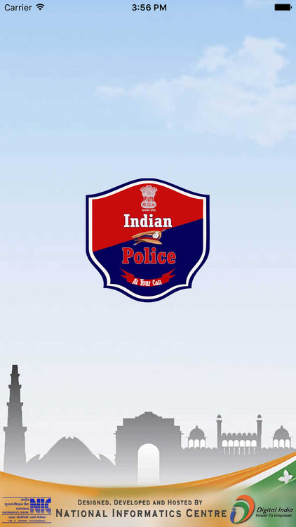
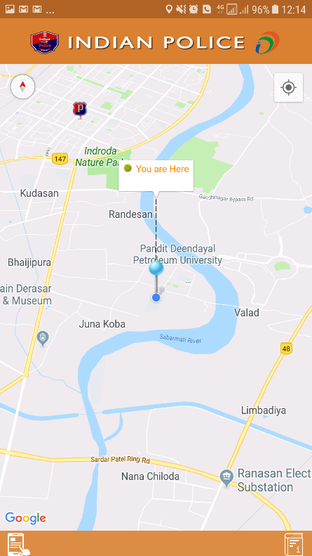
4. Suggested Partnership
Present Indian Mobile App

Slide 9
4. Suggested Partnership
Suggested Indian Mobile App

Slide 10
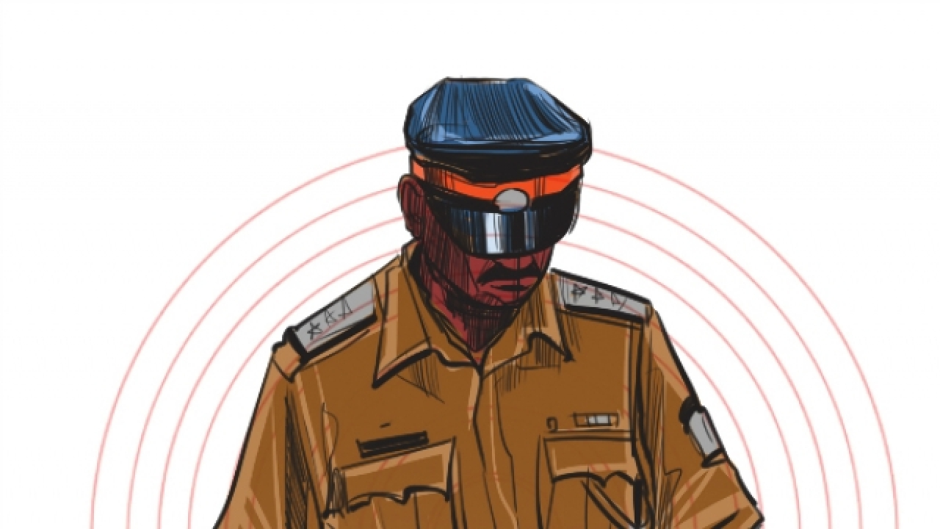
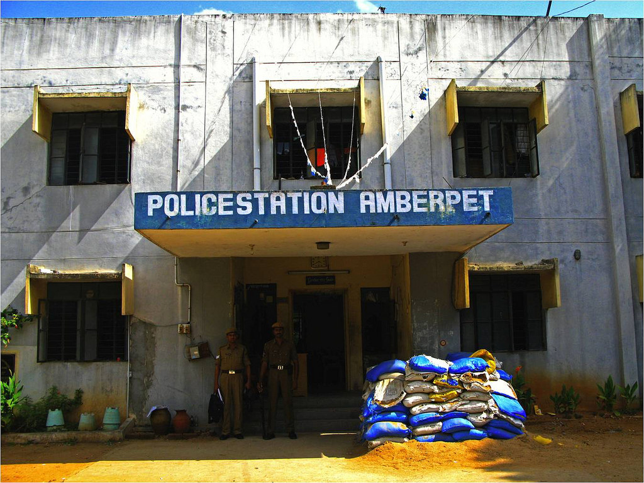
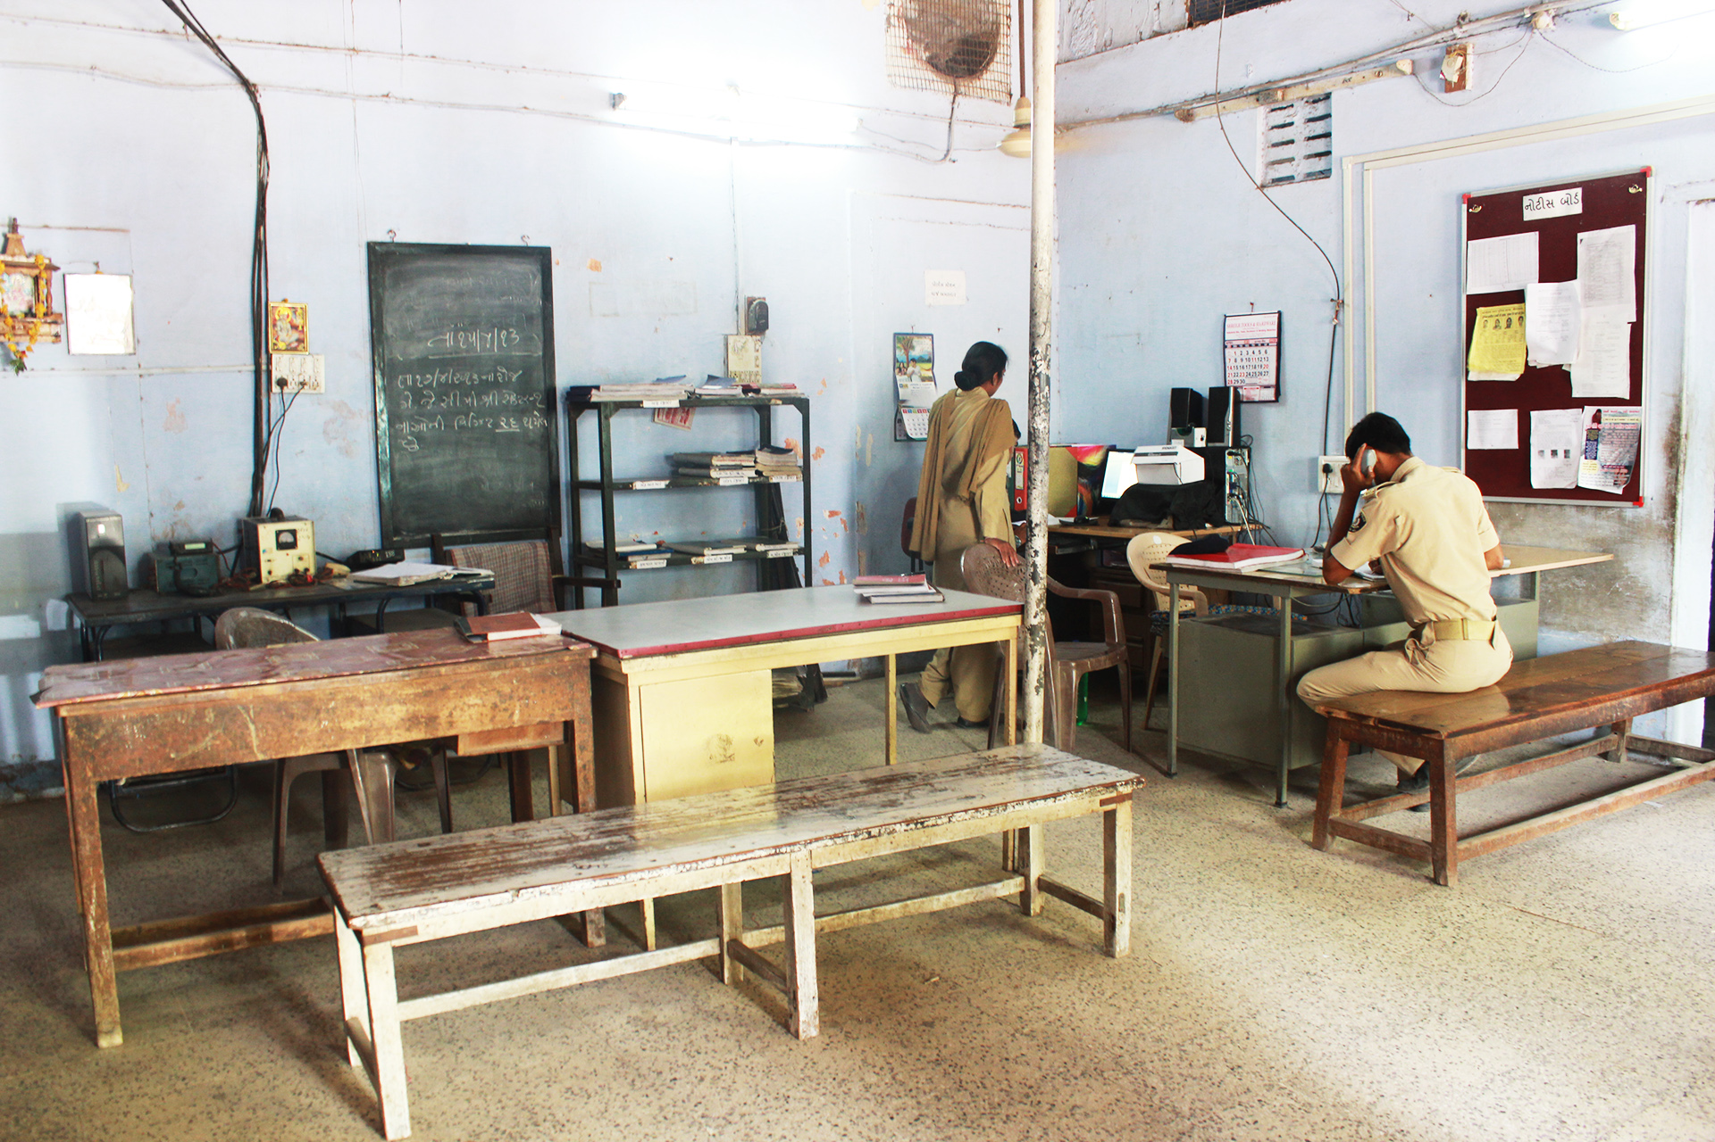
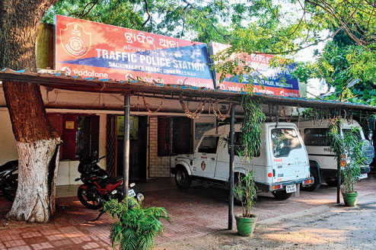
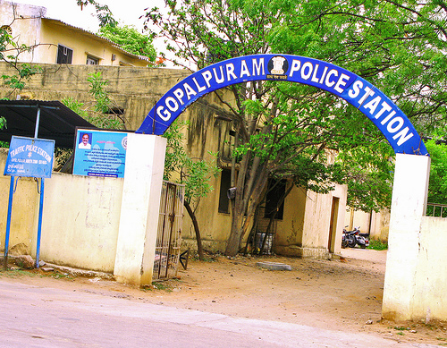
Poor Infrastructure

Slide 11
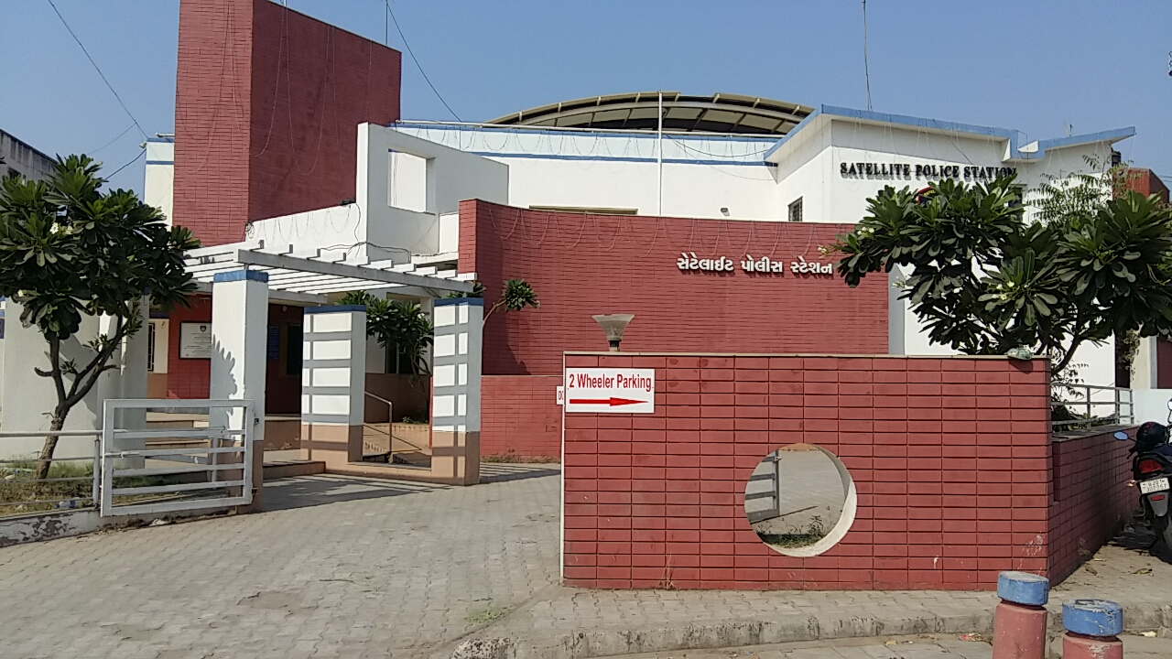
Suggested Partnership
Building of Police Stations/Chowkies
Satellite Police Station in Ahmedabad City which was built by Ahmedabad Nagrik Police Utkarsh Samiti at the cost of Rs. 90 lacs in the year 2005

Slide 12
Suggested Partnership
Building of Amenities for visitors

Slide 13
Suggested Partnership
Traffic Booth
Bruhat Bengaluru Mahanagara Palike (BBMP) will build and upgrade chowkies for traffic police at 530 junctions under PPP model. The BBMP has finalized on the design prepared by Janaagraha (an NGO) and has also collected specification of the chowkies from the police department

Slide 14
Suggested Partnership
Traffic Management
In Surat city, Traffic Regulation Brigade (TRB) was established to help traffic police in their duty. This was replicated in Anand, Ahmedabad, Rajkot, Vadodara, city also.

Slide 15
5. Concluding Remarks
We can see from the above discussion that PPP can play an important role in police administration and enhancing public delivery service. In India PPP not has not been used extensively used in police administration barring few examples.
There is urgent requirement of funding in this area which can be addressed with public’s participation.
CSR funds can also be earmarked for this purpose, for this we require government’s intervention by way of amendment in Companies Act, 2013.
Authors have suggested some doable plans by which performance of police administration can be made effective and efficient

Slide 16
www.klgupta.in
Dr. Kalpeshkumar L Gupta
kgupta@gnlu.ac.in
Mr. Mradul Mishra
mmishra@gnlu.ac.in

