Slide 1
Startup & Ease of Doing Business
LL.M. (2018-19)
Dr. Kalpeshkumar L Gupta
Assistant Professor - Research
kgupta@gnlu.ac.in
April 22, 2019

Slide 2
Dr. Kalpeshkumar L Gupta
Assistant Professor – Research
Faculty Coordinator GNLU Legal Incubation Council (GLIC)
Faculty Coordinator Police Academia Interaction Forum (PAIF)
Faculty Coordinator Gujarat Legal Education Project (GLEP)
Faculty Coordinator Project on Reducing Backlog of Cases
kgupta@gnlu.ac.in, kg@klgupta.in
Mob. 99248 97691, 81286 50857
probono-india.in
courtmanagement.in
2018
2016
2019
Notes:
1
2

Slide 3
Session Plan
Startup
Ease of Doing Business

Slide 4
Session Plan
Startup
Ease of Doing Business

Slide 5
Points to be pondered upon
What do you mean by startup?
Why startup needed?
Why startup succeed?

Slide 6
MINISTRY OF COMMERCE AND INDUSTRY (Department of Industrial Policy and Promotion) NOTIFICATION New Delhi, the 11th April, 2018
An entity shall be considered as a Startup:
i. Upto a period of 7 years from the date of incorporation/registration,
if it is incorporated as a private limited company (as defined in the Companies Act, 2013) or registered as a partnership firm (registered under section 59 of the Partnership Act, 1932) or a limited liability partnership (under the Limited Liability Partnership Act, 2008) in India.
In the case of Startups in the biotechnology sector, the period shall be upto 10 years from the date of its incorporation/ registration.
ii. Turnover of the entity for any of the financial years since incorporation/ registration has not exceeded Rs. 25 crore
iii. Entity is working towards innovation, development or improvement of products or processes or services, or if it is a scalable business model with a high potential of employment generation or wealth creation.
Cont…
https://dipp.gov.in/sites/default/files/Startup_Notification11April2018_0.pdf

Slide 7
Cont…
MINISTRY OF COMMERCE AND INDUSTRY (Department of Industrial Policy and Promotion) NOTIFICATION New Delhi, the 11th April, 2018
Provided that an entity formed by splitting up or reconstruction of an existing business shall not be considered a ‘Startup’.
Explanation
An entity shall cease to be a Startup on completion of 7 years from the date of its incorporation/ registration or if its turnover for any previous year exceeds Rupees 25 crore.
In respect of Startups in the biotechnology sector, an entity shall cease to be a Startup on completion of 10 years from the date of its incorporation/ registration or if its turnover for any previous year exceeds Rs. 25 crore.
https://dipp.gov.in/sites/default/files/Startup_Notification11April2018_0.pdf

Slide 8
Startups by GNLU Students
Legal Intern
ADR India

Slide 9
GNLU Legal Incubation Council (Sec. 8 Company)
IncMent
E-Cell
Research
IncMent - Incubation & Mentorship, it will incubate and mentor the startups.
E-Cell - Inculcate and promote culture of entrepreneurship by way of forming Entrepreneurship Cell, consisting of law and management students of the university.
Research - On entrepreneurship and allied aspects

Slide 10
Session Plan
Startup
Ease of Doing Business

Slide 11
Points to be pondered upon
What is ease of doing business?
What is the need of this ranking?

Slide 12
Ease of Doing Business
Top-selling publication of the World Bank Group.
Started in 2003
190 countries
Ease of doing business ranking of States of India is the annual ease of doing business index of states and union territories of India based on the completion percentage scores of action items points of annual Business Reforms Action Plan (BRAP) under the make in India initiative. This ranking of states has been done by World Bank since 2015 and facilitated by the Ministry of Personnel, Public Grievances and Pensions of Government of India based on the progress of states.

Slide 13
http://www.worldbank.org/content/dam/doingBusiness/media/Annual-Reports/English/DB2019-report_web-version.pdfc

Slide 14
Ease of Doing Business Report 2019
This work is a product of the staff of The World Bank with external contributions. The findings, interpretations, and conclusions expressed in this work do not necessarily reflect the views of The World Bank, its Board of Executive Directors, or the governments they represent.
The World Bank does not guarantee the accuracy of the data included in this work.
Doing Business 2019 is the 16th in a series of annual reports investigating the regulations that enhance business activity and those that constrain it.
Data in Doing Business 2019 are current as of May 1, 2018
http://www.worldbank.org/content/dam/doingBusiness/media/Annual-Reports/English/DB2019-report_web-version.pdfc

Slide 15
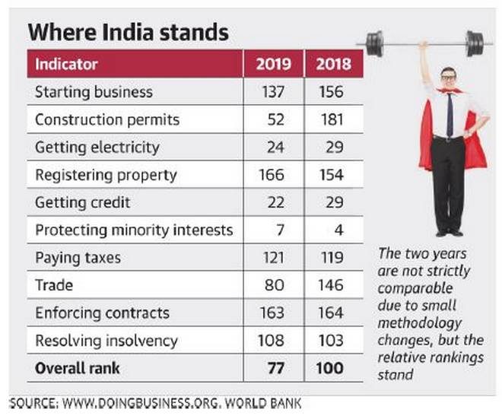
India Ranking

Slide 16
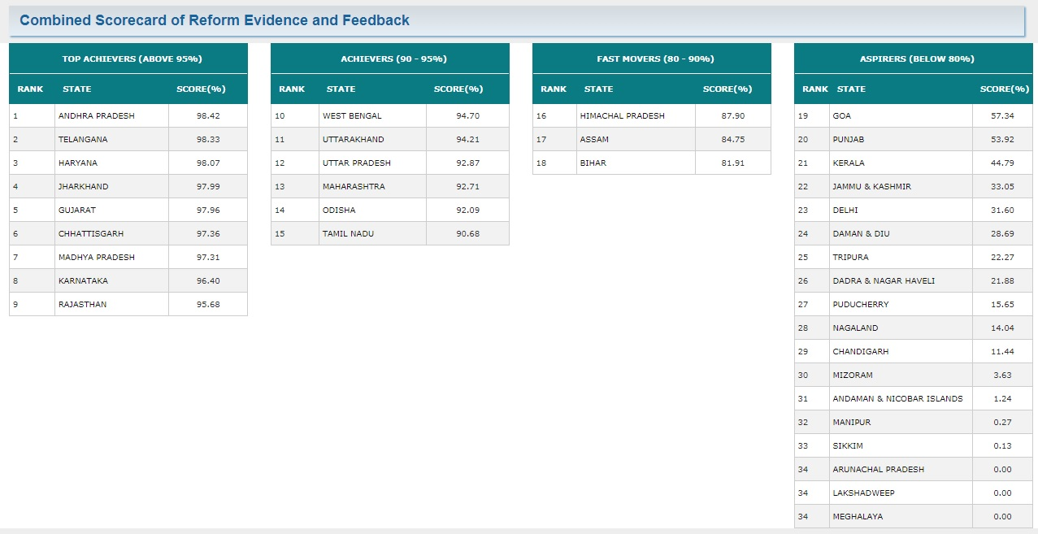
India States’ Ranking 2018
https://www.moneycontrol.com/news/business/economy/ease-of-doing-business-state-rankings-andhra-telangana-haryana-ranked-as-top-three-states-to-do-business-in-india-2692611.html

Slide 18
Indicators
http://www.worldbank.org/content/dam/doingBusiness/media/Annual-Reports/English/DB2019-report_web-version.pdfc

Slide 19
Indicators
http://www.worldbank.org/content/dam/doingBusiness/media/Annual-Reports/English/DB2019-report_web-version.pdfc

Slide 20
Methodology
The Doing Business data are based on a detailed reading of domestic laws, regulations and administrative requirements as well as their implementation in practice as experienced by private firms.
The report covers 190 economies—including some of the smallest and poorest economies, for which little or no data are available from other sources.
The data are collected through several rounds of communication with expert respondents (both private sector practitioners and government officials), through responses to questionnaires, conference calls, written correspondence and visits by the team.
Doing Business relies on four main sources of information: the relevant laws and regulations, Doing Business respondents, the governments of the economies covered and the World Bank Group regional staff
http://www.worldbank.org/content/dam/doingBusiness/media/Annual-Reports/English/DB2019-report_web-version.pdfc

Slide 21
Methodology
http://www.worldbank.org/content/dam/doingBusiness/media/Annual-Reports/English/DB2019-report_web-version.pdfc

Slide 22
Methodology
Samples
190 Countries, 194 cities
Cities
India (Mumbai & Delhi)
USA (New York , Los Angeles)
UK (London)
Pakistan (Karachi, Lahore)
New Zealand (Auckland)
Singapore
Korea (Seoul)
http://www.worldbank.org/content/dam/doingBusiness/media/Annual-Reports/English/DB2019-report_web-version.pdfc

Slide 23
Methodology
Respondents
Doing Business respondents More than 43,800 professionals in 190 economies have assisted in providing the data that inform the Doing Business indicators over the past 16 years.
This year’s report draws on the inputs of more than 13,800 professionals. The Doing Business website shows the number of respondents for each economy and each indicator set.
http://www.worldbank.org/content/dam/doingBusiness/media/Annual-Reports/English/DB2019-report_web-version.pdfc

Slide 24
Significance of Report
Governments and policy makers Doing Business offers policy makers a benchmarking tool useful in stimulating policy debate, both by exposing potential challenges and by identifying good practices and lessons learned.
http://www.worldbank.org/content/dam/doingBusiness/media/Annual-Reports/English/DB2019-report_web-version.pdfc

Slide 25
Advantages & Limitations of the Doing Business Methodology
http://www.worldbank.org/content/dam/doingBusiness/media/Annual-Reports/English/DB2019-report_web-version.pdfc

Slide 26
http://www.worldbank.org/content/dam/doingBusiness/media/Annual-Reports/English/DB2019-report_web-version.pdfc

Slide 27
http://www.worldbank.org/content/dam/doingBusiness/media/Annual-Reports/English/DB2019-report_web-version.pdfc

Slide 29
Dr. Kalpeshkumar L Gupta
www.klgupta.in

