Slide 1
Development of Food Laws in India
Faculty Development Programme
Organised by
Knowledge Consortium of Gujarat
Dr. Kalpeshkumar L Gupta
Associate Professor of Law
Parul Institute of Law, Parul University
July 8, 2020

Slide 2
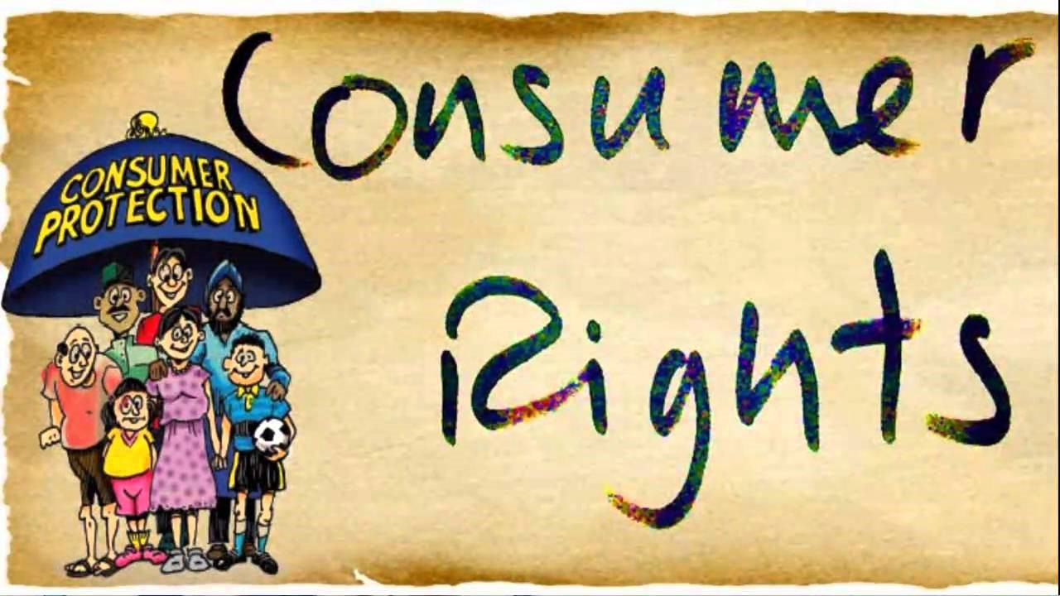
Consumer Protection Act, 2019 (Old 1986 Act)
Competition Act, 2002 (w.e.f. 2009)
Food Safety and Standards Act, 2006
Legal Metrology Act, 2009 (Old 1976 Act)
RERA Act, 2016

Slide 3
Outline
Introduction
Provisions of FSS Act, 2006
Recent Scenario/Cases/News

Slide 4
Outline
Introduction
Provisions of FSS Act, 2006
Recent Scenario/Cases/News

Slide 5
Time Line of Food Laws in India
1937
Committee Appointed by Central Advisory Board of Health
1955
Prevention of Food Adulteration Bill passed in 1954, came in to affect June 1, 1955
1998
Subject Group on Food & Agro Industries.
Recommended one comprehensive legislation
2004
Parliamentary Committee on Pesticide residue emphasized converge all food laws, single reg. body.
2006
FSSA Bill passed Came into force 2007, 2008, 2009
2005
Law Commission was also asked to give its view.
2005
Standing Committee of Parliament on Agriculture submitted for Integrated Food Laws.

Slide 6
Laws on Food & Allied Items
Vegetable Oil Products (Control) Order, 1947,
Prevention of Food Adulteration Act, 1954 ,
Fruit Products Order , 1955,
Solvent Extracted Oil, De- Oiled Meal and Edible Flour (Control) Order, 1967,
Meat Food Products Order , 1973,
Edible Oils Packaging (Regulation) Order 1988,
Milk and Milk Products Order, 1992
………repealed after commencement of FSS Act, 2006.

Slide 7
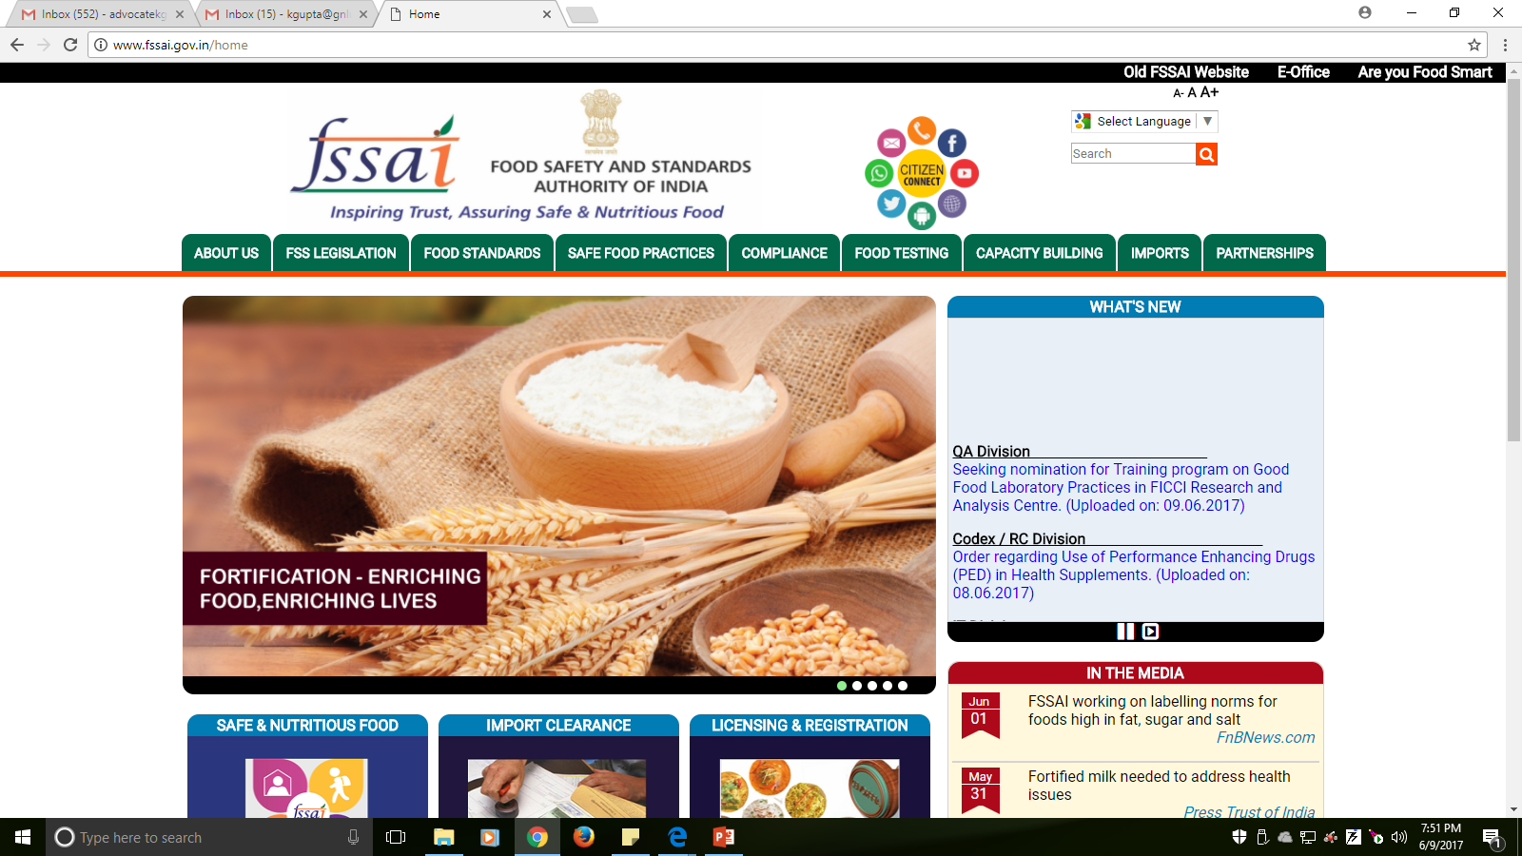

Slide 8
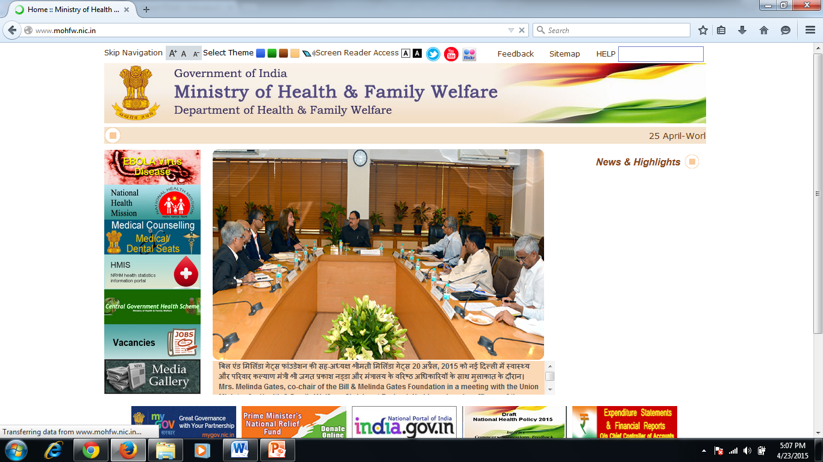
Implementing Ministry of FSSAI

Slide 9
Outline
Introduction
Provisions of FSS Act, 2006
Recent Scenario/Cases/News

Slide 10
Objectives of the Act
An Act to consolidate the laws relating to food and
to establish the Food Safety and Standards Authority of India for laying down science based standards for articles of food and to regulate their manufacture, storage, distribution, sale and import, to ensure availability of safe and wholesome food for human consumption and for matters connected therewith or incidental thereto.
August 24, 2006 came into effect.

Slide 11
Some important terms
Adulterant (Section 3(a)).. can cause food unsafe/sub-standard/mis-branded
Contaminant (Section 3(g)..present in food as a result of the production, manufacture, processing, preparation, treatment, packing, transport.
Food (Section 3(j) extensively defined
Food Additive (Section 3(k)) typical ingredients of the food
Food Business (Section 3 (n)) for profit or not
Food Business Operator (Section 3(o))..umbrella term
Food Safety (Section 3(q))..accepted for human consumption
Sub Standard (Section 3 (zx)..does not meet specified standard
Unsafe Food (Section 3 (zz))..injurious to health

Slide 12
Section 4 :- Establishment of FSSAI
Central Govt. will establish Food Safety & Standards Authority of India.
Head Office at New Delhi.
Food Authority may establish its offices at any other places in India.
A Chairperson, 22 members out of which one third shall be women (Section 5).
Term for 3 years, eligible for re-appointment (Section 7)
CEO will see day to day activities of food authority (Section 9).

Slide 13
Organizational Structure
FSSAI
(Sec. 4)
New Delhi
CEO (Sec. 9)
Scientific Panels (Sec. 13)
Scientific Committee (Sec. 14)
Central Advisory Committee (Sec. 11)
Designated Officer (Sec. 36)
State Food Safety Authority (Sec. 29)
Commissioner of Food Safety (Sec. 30)
Food Safety Officer (Sec. 37)
Food Analyst
(Sec. 45)

Slide 14
Section 16 :- Functions of Food Authority
Food Authority to regulate and monitor the manufacture, processing, distribution, sale and import of food so as to ensure safe and wholesome food.
It will provide scientific advice and technical support to the Central Government and the State Governments in matters of framing the policy and rules in areas which have a direct or indirect bearing on food safety and nutrition;
Other works as mentioned in the act.

Slide 15
Section 24 :- Restrictions of advt. & prohibition as to unfair trade practice.
No advertisement shall be made of any food which is misleading or deceiving or contravenes the provisions of this Act, the rules and regulations made thereunder.
No person shall engage himself in any unfair trade practice for purpose of promoting the sale, supply, use and consumption of articles of food or adopt any unfair or deceptive practice including the practice of making any statement, whether orally or in writing or by visible representation.
………Provided that where a defence is raised to the effect that such guarantee is based on adequate or scientific justification, the burden of proof of such defence shall lie on the person raising such defence.

Slide 16
Section 26 :- Responsibilities of the Food Business Operator
Every food business operator shall ensure that the articles of food satisfy the requirements of this Act and the rules and regulations made thereunder at all stages of production, processing, import, distribution and sale within the businesses under his control.
Section 27 :- Liability of manufacturer, packers, wholesalers, distributors and sellers
Liabilities are mentioned separately for
Manufacturer & Packers
Wholesalers, distributors
Sellers

Slide 17
Section 28 :- Food Recall* Procedures
Initiate process for recall if food is not in compliance of the act.
Immediately inform competent authorities.
Food business operator will follow guidelines relating to food recall procedure.
Food Safety and Standards (Food Recall Procedure) Regulations, 2017
*Regulation 2(c) “food recall” means the action to remove food from the market at any stage of the food chain, including that possessed by consumers;

Slide 18
Section 29 :- Authorities responsible for enforcement of Act
The Food Authority and the State Food Safety Authorities shall be responsible for the enforcement of this Act.
They shall monitor and verify that the relevant requirements of law are fulfilled by food business operators at all stages of food business.

Slide 19
Section 30:- Commissioner of the Food Safety
State Govt. shall appoint the Commissioner of Food Safety for the state for efficient implementation of food safety and standards.

Slide 20
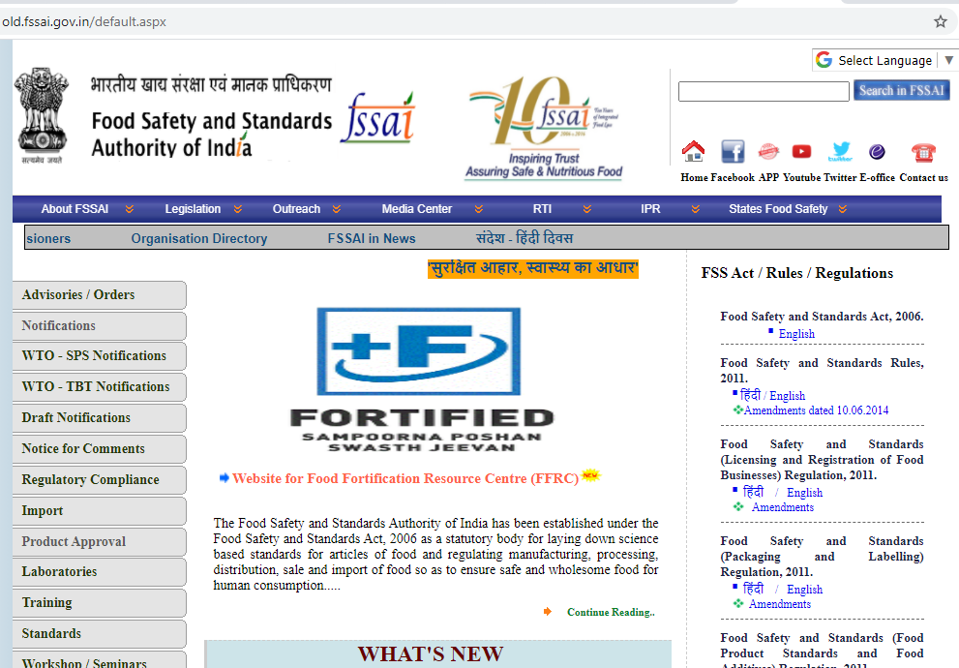

Slide 21
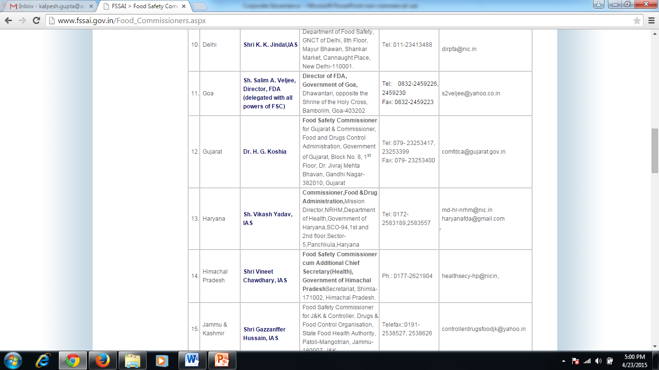
Commissioners Food Safety/Officer-In-Charge For Food Safety In States/UTS
https://www.fssai.gov.in/cms/commissioners-of-food-safety.php

Slide 22
Section 31:- Licensing & Regi. Of food business
No food business except under a licence.
Not applicable to *petty manufacturer but they will register themselves as prescribed.
If licence is not issued in 2 months or application is not rejected, the applicant may start his food business.
*Petty manufacturer means any food manufacturer, who
(a) manufactures or sells any article of food himself or a petty retailer, hawker, itinerant vendor or
temporary stall holder; or distributes foods including in any religious or social gathering except a caterer; or
(b) such other food businesses including small scale or cottage or such other industries relating to food business or tiny food businesses with an annual turnover not exceeding Rs 12 lakhs and/or whose
(i) production capacity of food (other than milk and milk products and meat and meat products) does not exceed 100 kg / ltr per day or
(ii) procurement or handling and collection of milk is up to 500 litres of milk per day or
(iii) slaughtering capacity is 2 large animals or 10 small animals or 50 poultry birds per day or less.
Licensing Regulation 2011

Slide 23
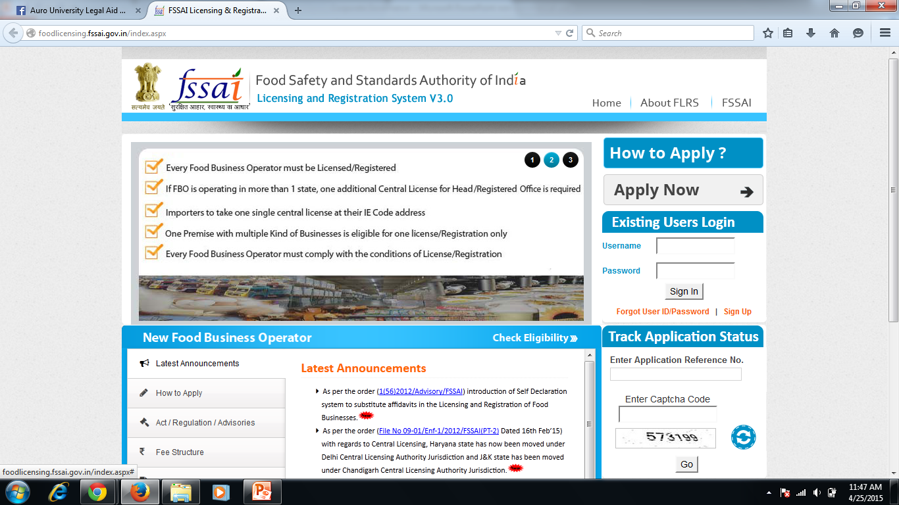

Slide 24
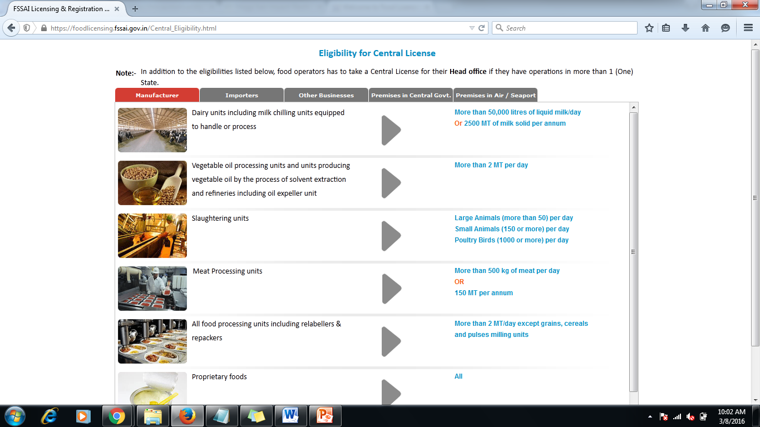

Slide 25
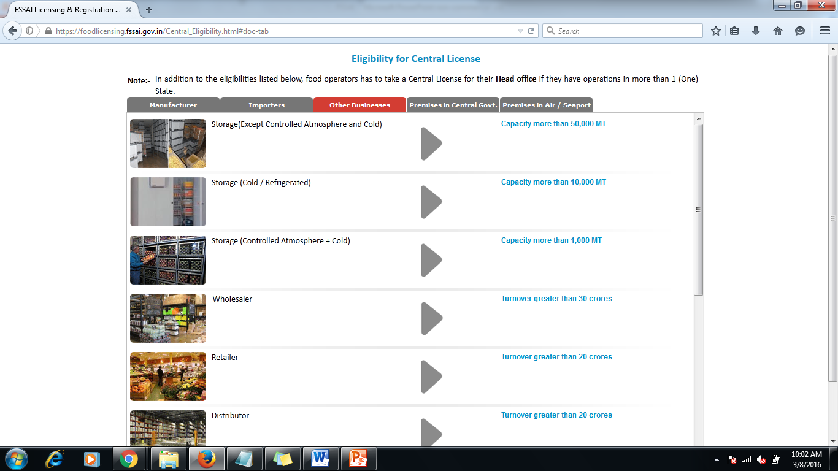

Slide 26
Section 35:- Notification of food poisoning
The Food Authority may, by notification, require registered medical practitioners carrying on their profession in any local area specified in the notification,
……to report all occurrences of food poisoning coming to their notice to such officer as may be specified.

Slide 27
Section 36:- Designated Officer
The Commissioner of Food Safety shall appoint Designated Officer for each district.
Functions
It will issue or cancel licence of food business operators.
It will prohibit the sale of any article of food which is in contravention of the provisions of this act.
To make recommendation to the Commissioner of Food Safety for sanction to launch prosecution in case of contraventions punishable with imprisonment.
To maintain record of all inspections made by Food Safety Officers and actions taken by them in the performance of their duty.

Slide 28
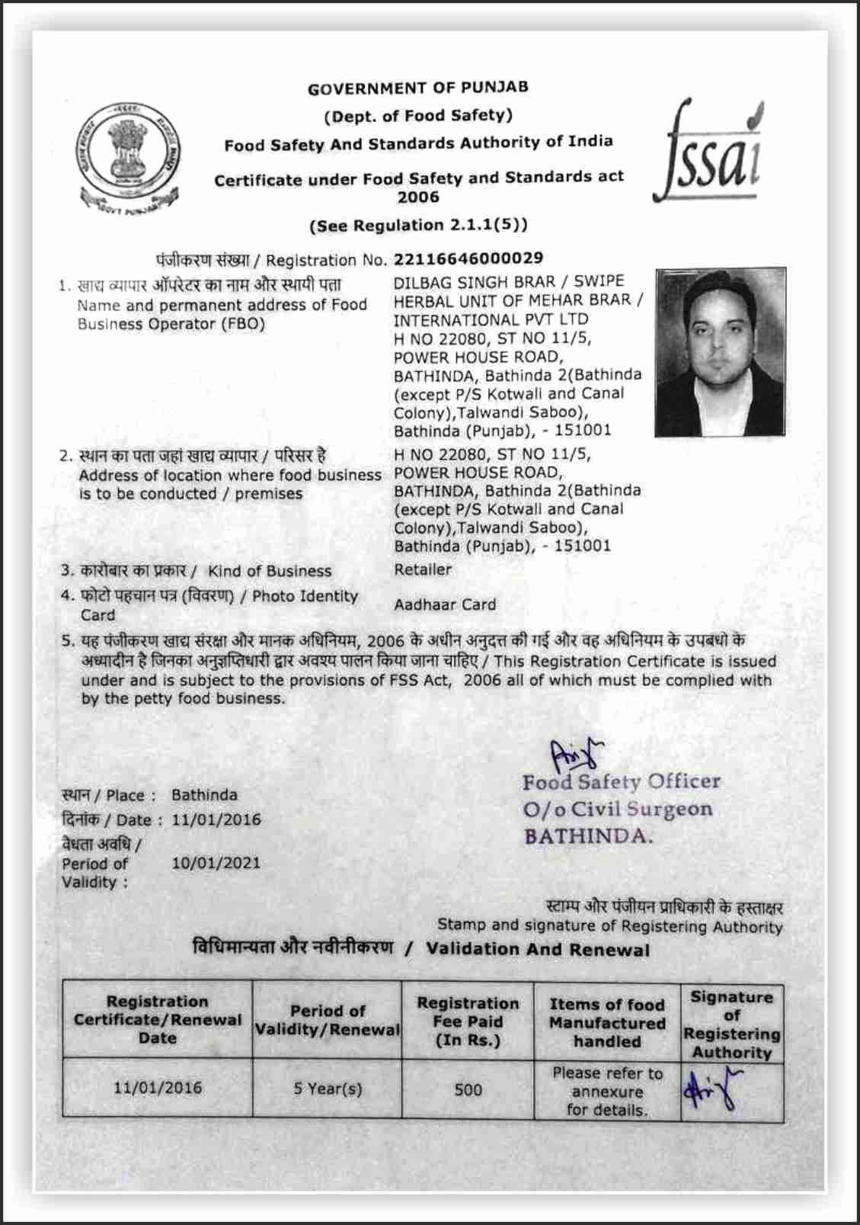

Slide 29
Section 37:- Food Safety Officer
The Commissioner of Food Safety shall appoint Food Safety Officers
The State Govt. may authorize any officer of the state govt. to perform the functions of a Food Safety Officer.
Powers (Section 38)
Take sample of any food, seize any article of food, enter in premises of food operators and inspect.
FSO will follow the guidelines issued by Commissioner of Food Safety from time to time.

Slide 30
Organizational Structure… example
State Food Safety Authority (Sec. 29)
@ Jivraj Mehta Bhavan , Gandhinagar
Commissioner of Food Safety (Sec. 30)
@ Jivraj Mehta Bhavan , Gandhinagar
Food Analyst
(Sec. 45)
Designated Officer
(Sec. 36)
e.g. @ Food & Drug Control Admin.
Surat Municipal Corporation
10 Food Analysts
Food Safety Officer
(Sec. 37)
e.g. Office of the Assistant Commissioner, Food & Drugs Control Administration, Gov. Multistoried Building, 2nd Floor, Majura Gate, Surat

Slide 31
Section 39:- Liability of Food Safety Officer in certain cases
Any Food Safety Officer exercising powers under this Act or the rules and regulations made thereunder who –
(a) vexatiously and without any reasonable ground seizes any article of food or adulterant; or
(b) commits any other act to the injury of any person without having reason to believe that such act is necessary for the execution of his duty and shall be liable to a penalty which may extend to 1 lakh rupees:
Any false complaint is made against a Food Safety Officer, the complainant shall be punishable with fine which shall not be less than fifty thousand rupees but may extend to 1 lakh rupees.

Slide 32
Section 40:- Purchaser may have food analyzed.
Purchaser also can get food analyzed by food analyst on payment of prescribed fees.
Provided that such purchaser inform Food Business Operator at time of purchase of his intention to have such article so analyzed.
If food analyst found that food is not in compliance with the Act or rules or regulations, the purchaser shall be entitled to get refund of the fees paid.
Food Analyst find the sample in contravention of provisions of this act and rules and regulations, the food analyst shall forward the report to the Designated Officer for prosecution under Section 42.

Slide 33
Section 42:- Procedure for launching prosecution
Food Safety Officer shall be responsible for inspection of food business, drawing samples and sending them to Food Analyst for analysis.
Food Analyst will send report to Designated Officer with a copy to Commissioner of Food Safety within 14 days.
Designated Officer will decide the case after analyzing the report with the consultation with Commissioner of Food Safety.

Slide 34
Prosecution
Commissioner of Food Safety
@ Gandhinagar
Decision to launch prosecution
Report to CFS
Designated Officer
e.g. @ Surat Municipal Corporation
Report to DO
Food Analyst
u/s 40
(Purchaser’s Sample
Food Safety Officer u/s 42
e.g. @ Surat Local Area appointed by Commissioner
e.g. @ Surat Municipal Corporation

Slide 35
Section 51:- Penalty for sub-standard food
Any person who whether by himself or by any other person on his behalf manufactures for sale or stores or sells or distributes or imports any article of food for human consumption which is sub-standard,
shall be liable to a penalty which may extend to 5 lakh rupees.

Slide 36
Section 53:- Penalty for misleading advertisement
Any person who publishes, or is a party to the publication of an advertisement, which –
falsely describes any food; or
(b) is likely to mislead as to the nature or substance or quality of any food or gives false guarantee, shall be liable to
a penalty which may extend to 10 lakh rupees.
"Advertising Standard Council of India (ASCI) will comprehensively monitor these advertisements across various media. The council has been given a suo motu monitoring mandate by FSSAI to process complaints against misleading advertisements of food and beverages," ASCI General Secretary Shweta Purandare said.
- Economics Times, June 29, 2016

Slide 37
Section 56:- Penalty for unhygienic or unsanitary processing or mfg. of food
Any person who, whether by himself or by any other person on his behalf, manufactures or processes any article of food for human consumption under unhygienic or unsanitary conditions,
shall be liable to a penalty which may extend to 1 lakh rupees.

Slide 38
Section 57:- Penalty for possessing adulterant
(1) Subject to the provisions of this chapter, if any person who whether by himself or by any other person on his behalf, imports or manufactures for sale, or stores, sells or distribute any adulterant shall be liable –
(i) where such adulterant is not injurious to health, to a penalty not exceeding 2 lakh rupees;
(ii) where such adulterant is injurious to health, to a penalty not exceeding 10 lakh rupees.
(2) In a proceeding under sub-section (1), it shall not be a defence that the accused was holding such adulterant on behalf of any other person.

Slide 39
Section 59:- Punishment for unsafe food
Does not result in injury…
imprisonment upto 6 months & fine upto 1 lakh rupees.
Non-grievous injury…
imprisonment 1 year & fine upto 3 lakh rupees.
Grievous injury…
imprisonment 6 years & fine upto 5 lakh rupees.
Death….
not less than 7 years imprisonment may extend for life and fine not less than 10 lakh rupees.

Slide 40
Section 64:- Punishment for subsequent offences.
If any person, after having been previously convicted of an offence punishable under this Act subsequently commits and is convicted of the same offence, he shall be liable to—
(i) twice the punishment, which might have been imposed on a first conviction, subject to the punishment being maximum provided for the same offence;
(ii) a further fine on daily basis which may extend up to 1 lakh rupees, where the offence is a continuing one; and
(iii) his licence shall be cancelled.

Slide 41
Section 65:- Compensation in case of injury or death of consumer.
If any person whether by himself or by any other person on his behalf, manufactures or distributes or sells or imports any article of food causing injury to the consumer or his death, it shall be lawful for the Adjudicating Officer or as the case may be, the court to direct him to pay compensation to the victim or the legal representative of the victim, a sum—
not less than 5 lakh rupees in case of death;
(b) not exceeding 3 lakh rupees in case of grievous injury; &
(c) not exceeding 1 lakh rupees, in all other cases of injury:

Slide 42
Section 68:- Adjudication
For the purposes of adjudication under this Chapter, an officer not below the rank of Additional District Magistrate of the district where the alleged offence is committed, shall be notified by the State Government as the Adjudicating Officer for adjudication in the manner as may be prescribed by the Central Government.
Section 70:- Food Safety Appellate Tribunal
The Central Government or as the case may be, the State Government may, by notification, establish one or more tribunals to be known as the Food Safety Appellate Tribunal to hear appeals from the decisions of the Adjudicating Officer under section 68.

Slide 43
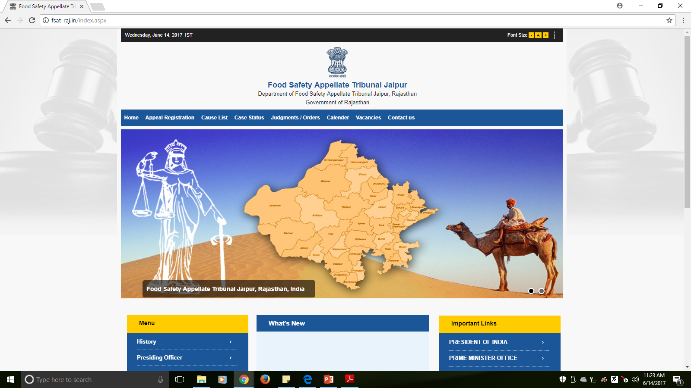
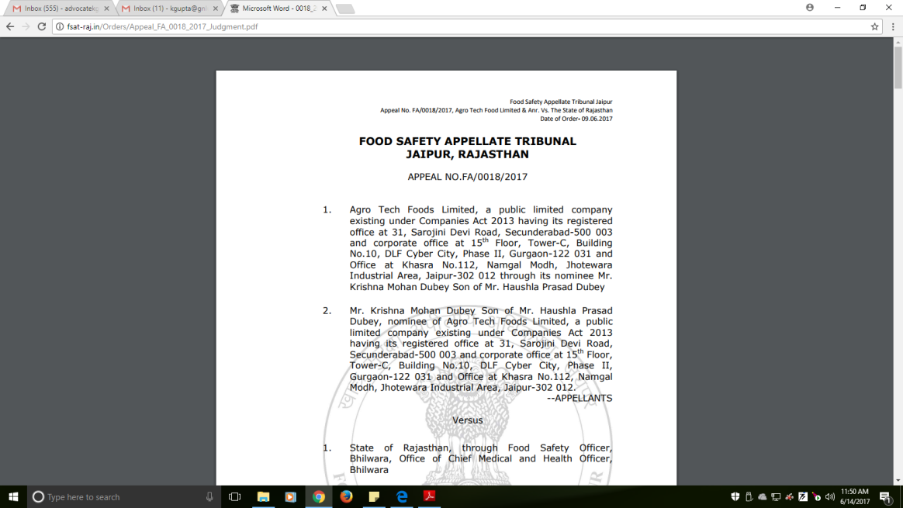
http://fsat-raj.in/index.aspx

Slide 44
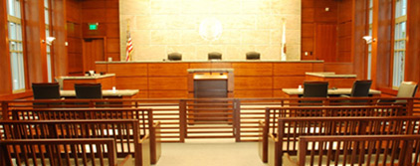
Section 74:- Special Courts & Public Prosecutor.
Special Courts can be established for certain cases and public prosecutor and additional public prosecutors can be appointed.
Section 75:- Power to transfer cases to regular courts
Special Court will transfer the cases if it is of the opinion that the offence is not triable by it.

Slide 45
Section 76:- Appeal
Appeal can be filed against the order of Special Court to High Court within 45 days from the date on which the order was served.
Appeal shall be disposed by the High Court by a bench of not less than 2 judges.

Slide 46
Case Flow
High Court
(u/s. 76)
Special Court
(u/s. 74)
Food Safety Tribunal
(u/s. 70)
Regular Court
(u/s. 75)
Adjudication
(u/s. 68)

Slide 47
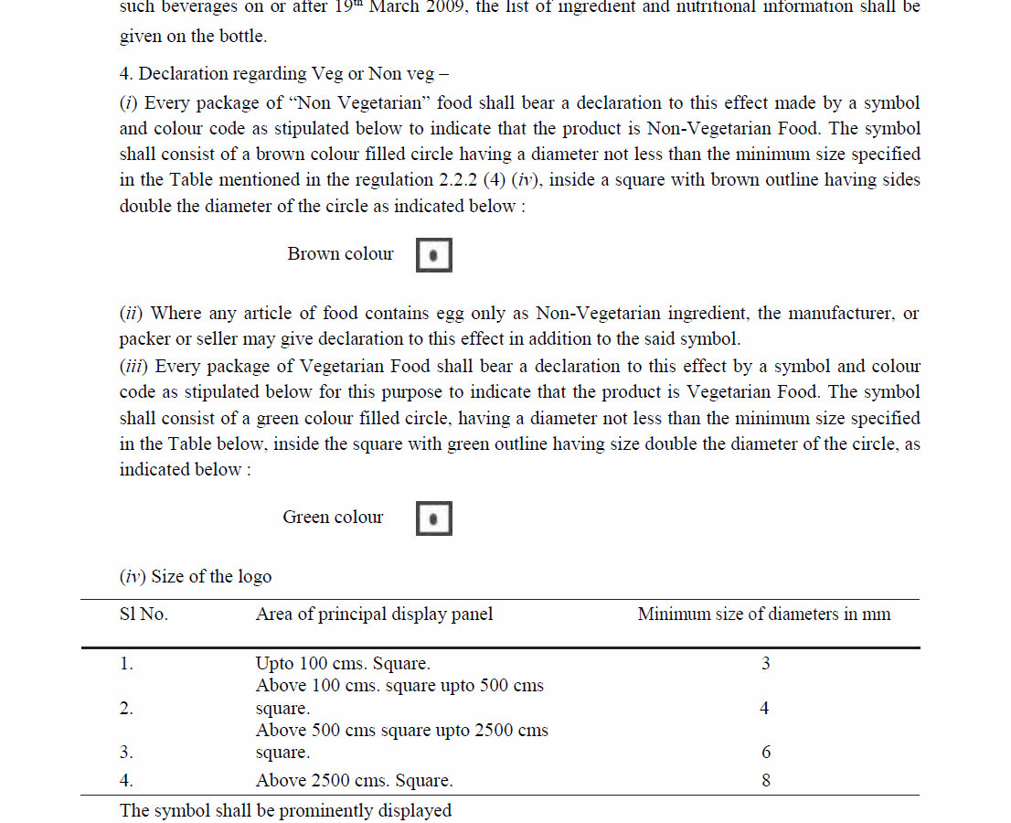
FOOD SAFETY AND STANDARDS
(PACKAGING AND LABELLING) REGULATIONS, 2011

Slide 48
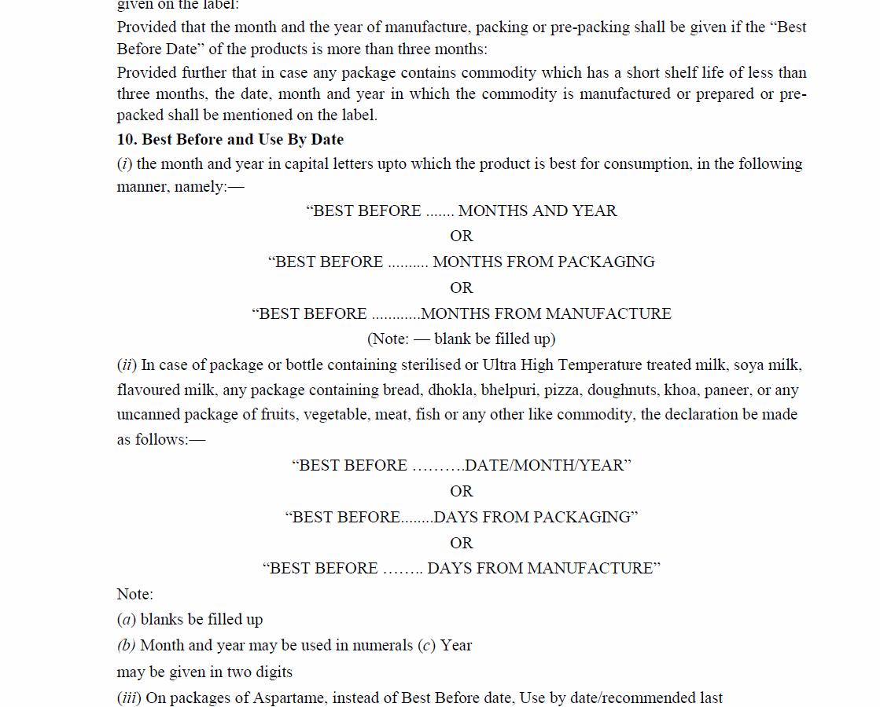
FOOD SAFETY AND STANDARDS
(PACKAGING AND LABELLING) REGULATIONS, 2011

Slide 49
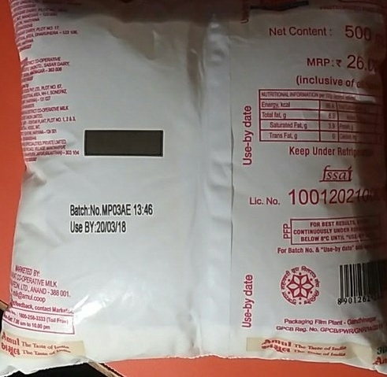

Slide 50
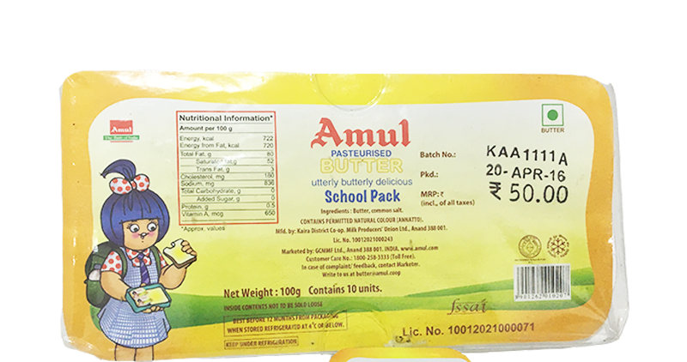

Slide 51
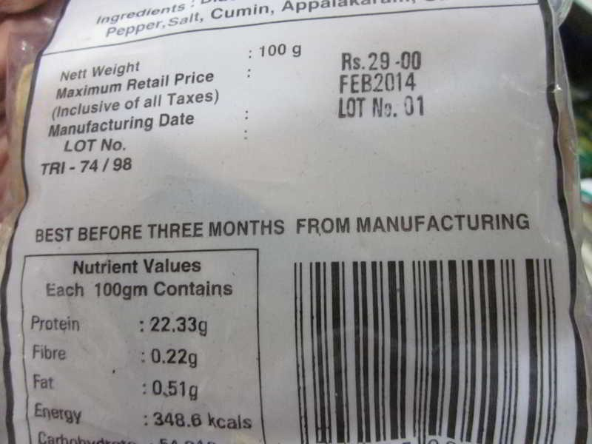
FOOD SAFETY AND STANDARDS
(PACKAGING AND LABELLING) REGULATIONS, 2011

Slide 52
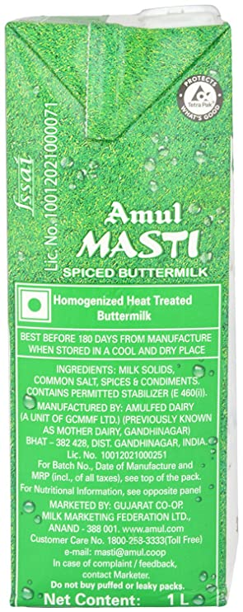
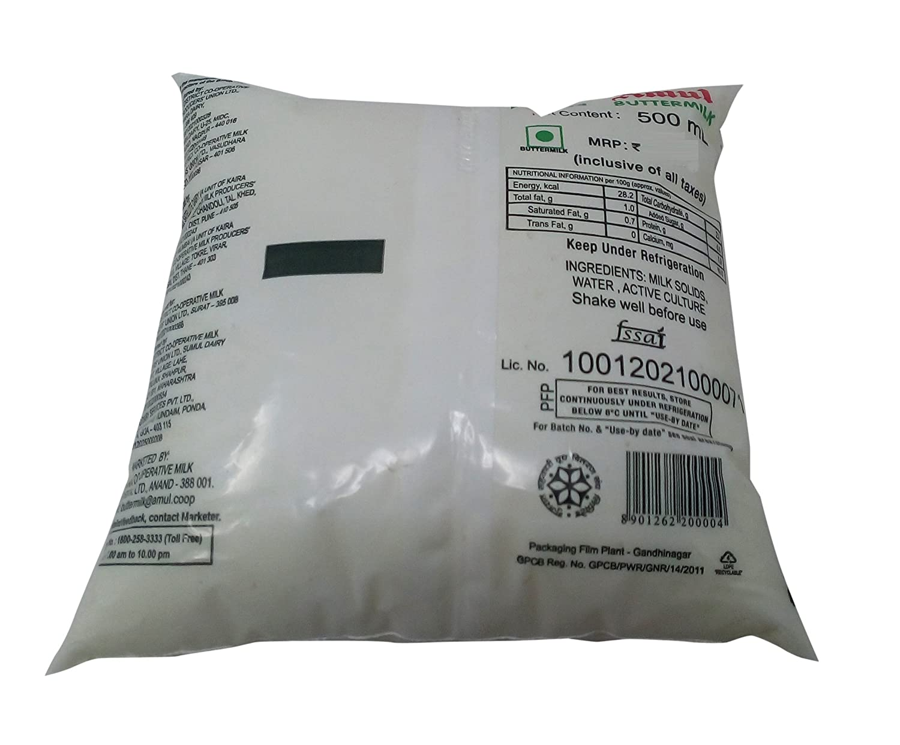
Use By

Slide 53
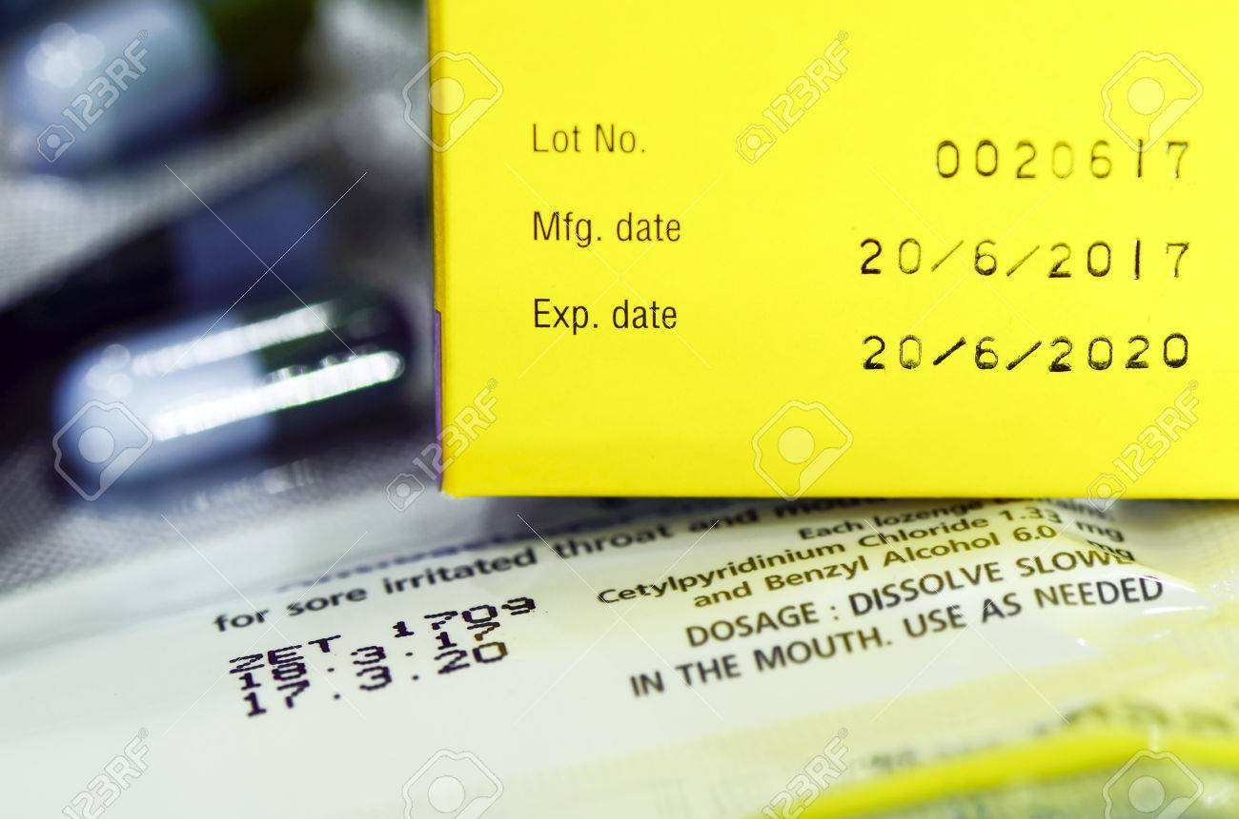

Slide 54
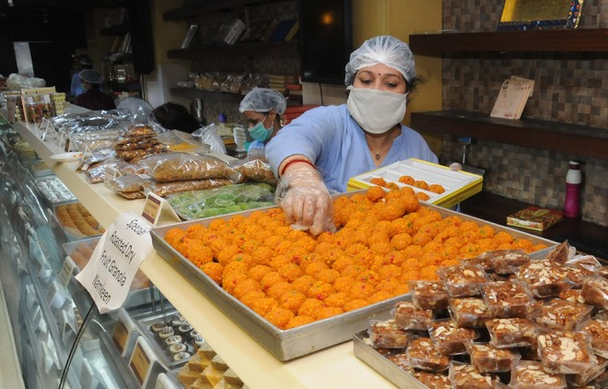
Best Before on Sweets from October 1, 2020
No compulsion on Mfg date.

Slide 55
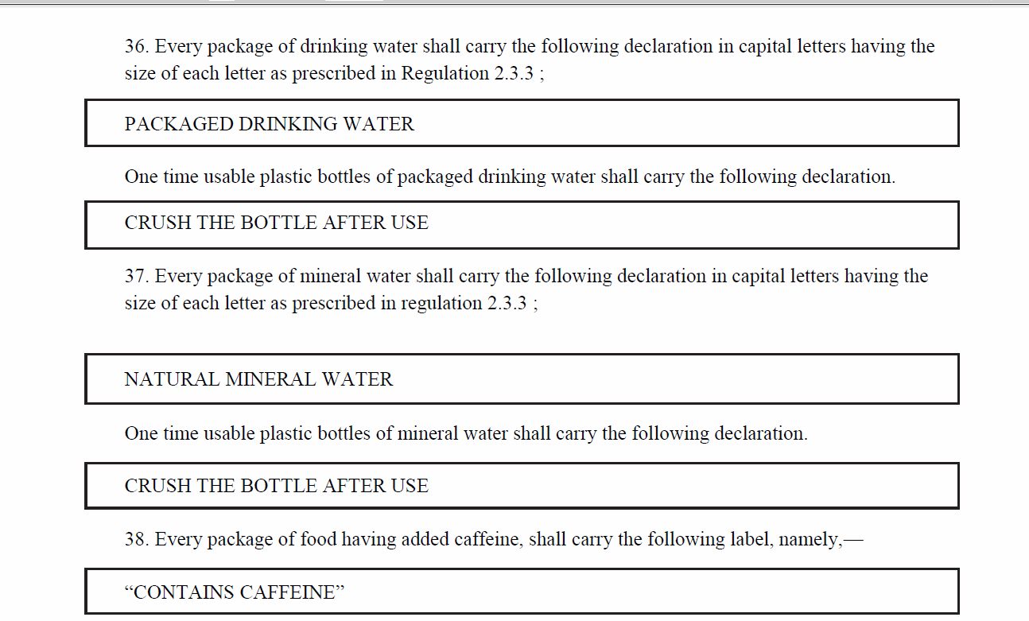
FOOD SAFETY AND STANDARDS
(PACKAGING AND LABELLING) REGULATIONS, 2011

Slide 56
Outline
Introduction
Provisions of FSS Act, 2006
Recent Scenario/Cases/News

Slide 57
Action against misleading advertisement
The Hindu, August 8, 2010
FSSAI has directed the state food safety commissioner to scrutinize and initiate stringent action against advertisement which raise misleading claims on the quality of food and beverages being marketed in the state.
Exaggeration of Quality
Companies will not use edible oil as super Refined, Extra Refined, Double Refined, Ultra Refined, cholesterol friendly etc. This ad allegedly try to deceive the customer.
Cases will be registered under FSS Act and proved guilty. It will invite penalty of Rs. 10 Lakh (Section 53). The burden to prove the claim will be on the company and it should be supported with scientific evidences.

Slide 58
Food safety being compromised due to use of pesticide: Centre for Science and Environment
The Economics Times, April 7, 2015
"Consumption of junk food and other chemically-laced food adds to the problem," the Centre for Science and Environment (CSE) deputy director general Chandra Bhushan said while flagging the nation's key concerns on World Health Day.
Observing that the Food Safety and Standards (FSS) Act should be strengthened, CSE noted that an effective monitoring mechanism is the "key" to the success of Indian food safety regulatory framework while limited capacity of enforcement authorities should not be a hindrance and should be augmented. It also called for imposition of financial and legal penalties in order to ensure deterrence.

Slide 59
Surveillance of foodborne diseases: Lack of labs, personnel biggest hurdle
The Economics Times, March 13, 2015
The government, which does not have data on foodborne diseases, is facing the challenge of putting in place a surveillance system that can help identify and investigate outbreaks due to lack of labs and health professionals in the field of Epidemiology.

Slide 60
Some Headlines
FSSAI allows up to 5% vegetable fats in chocolates Economics Times, May 25, 2017
Milk adulteration more in North India: FSSAI Economics Times, April 17, 2017
FSSAI to bring new regulations for organic foods Economics Times, February 9, 2017
FSSAI wants edible oil manufacturers to make small packs for rural India Economics Times, April 18, 2017

Slide 61
Some Headlines
FSSAI ties up with US firm Decernis Ltd to get access to global standards. Economics Times, April 12, 2017
FSSAI ties up with Coca-Cola to train 50,000 food vendors. Economics Times, March 27, 2017 FSSAI bans 'Carcinogenic' additive potassium bromate in bread.
Economics Times, June 21, 2016
The CSE study had found that 84% of 38 commonly available brands of
pre-packaged breads, including pav and buns, tested positive for
potassium bromate and potassium iodate. These two food additives are
banned in many countries and listed as "hazardous" for public health.

Slide 62
Some Headlines
Deadline to display ‘best before’, mfg date for loose sweets extended till Oct 1 : FSSAI Economics Times, July 24, 2020
FSSAI moves to stop use of word ‘milk’ on non-dairy products Economics Times, August 25, 2020

Slide 63
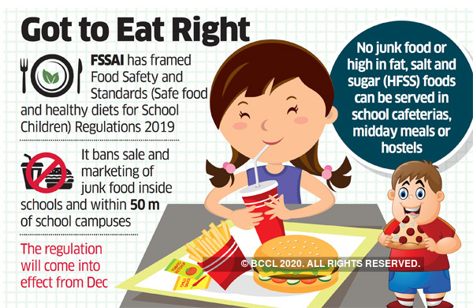
Some Headlines

Slide 64
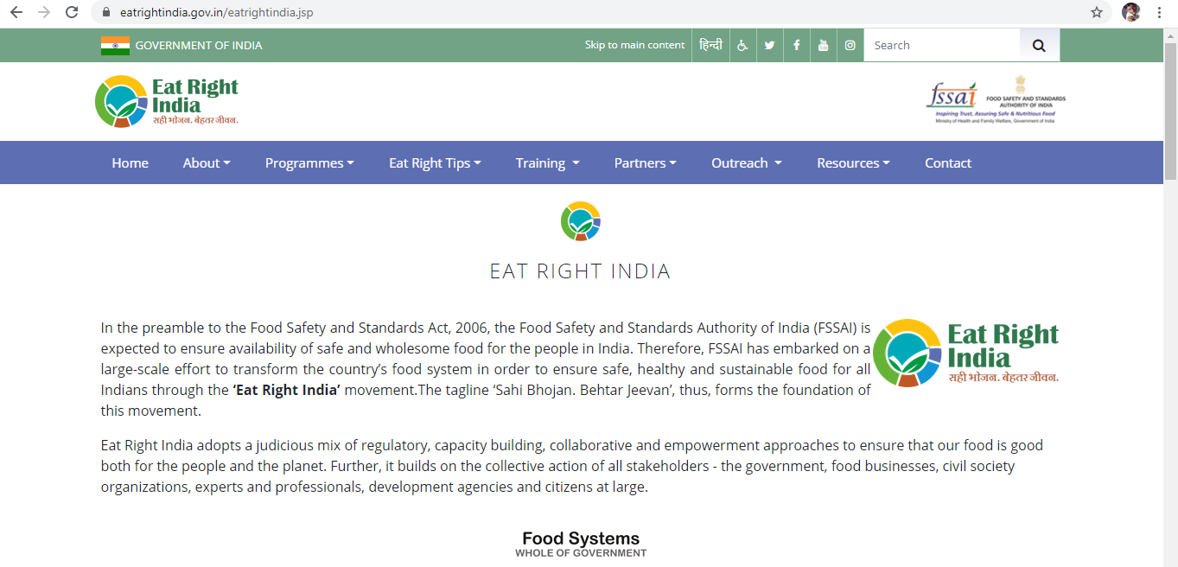
Some Headlines

Slide 65
Some Headlines
Estb. 1985,
Self Regulating Body
ASCI, FSSAI collaborate to curb misleading claims in foods & beverages ads
Read more at: https://economictimes.indiatimes.com/industry/services/advertising/asci-fssai-collaborate-to-curb-misleading-claims-in-foods-beverages-ads/articleshow/84143700.cms?utm_source=contentofinterest&utm_medium=text&utm_campaign=cppst

Slide 66
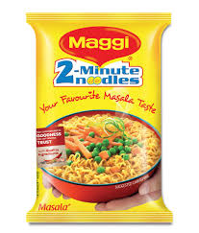
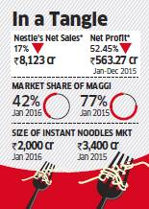
Maggi ban impact: Nestle India may take 3 years to recover
Read more at: http://economictimes.indiatimes.com/articleshow/51114562.cms?utm_source=contentofinterest&utm_medium=text&utm_campaign=cppst February 24, 2016

Slide 67
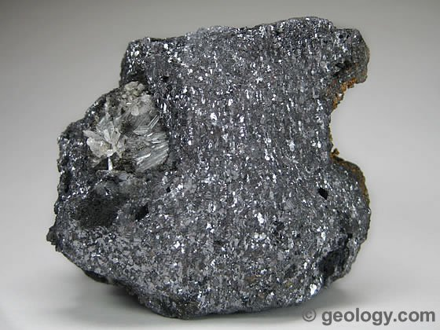
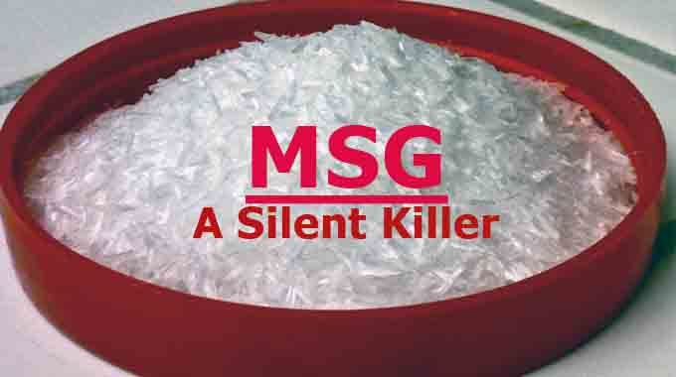
Monosodium Glutamate.
Lead
MSG 500 mg/kg
Lead 10mg/kg
FOOD SAFETY AND STANDARDS (FOOD PRODUCTS STANDARDS AND FOOD ADDITIVES) REGULATIONS, 2011

Slide 68
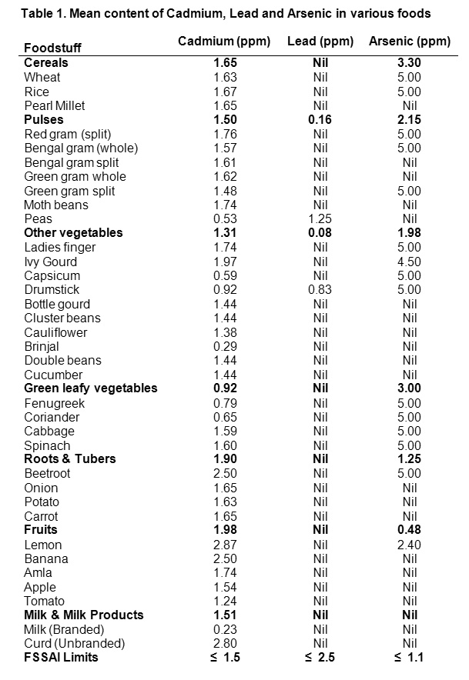
……..samples contained 17.2 parts per million (ppm) of lead, many times the allowable limits which range between 0.01 and 2.5 ppm.”
1 ppm = 1 mg
1000mg = 1 gm
1000gm = 1 Kg

Slide 70
http://www.indiaenvironmentportal.org.in/files/nestle-vs-fssai-in-bombay-hc.pdf

Slide 71
The court held that Food Safety and Standards Authority of India (FSSAI) had acted in an “arbitrary” manner when it banned the Maggi noodles. The regulator will now have to justify its ban by conducting fresh tests, failing which Nestle could return Maggi to shelves.
https://www.legallyindia.com/the-bench-and-the-bar/bombay-hc-rules-for-maggi-fssai-acted-arbitrarily-20150813-6432

Slide 72
And continues….

Slide 73
Issues Involved
Writ Petition under Article 226 by Petitioner..maintainable ?
Suppression of the fact on the part of petitioner?
Ban could have been imposed by CEO, FSSAI
FSSAI discretion to decide standard for proprietary food
Complete ban on sale of products under Section 22
Violation of Principle of Natural Justice on the part of all respondent.
Source of power, impugned order was passed
Testing of sample and report
Reliance on petitioner’s own laboratory report
Food Analysts entitlement to test sample in any laboratory
Authority stated product was Misbranded
Ban on all 9 variants, test conducted on 3 variants..Justifiable?

Slide 74
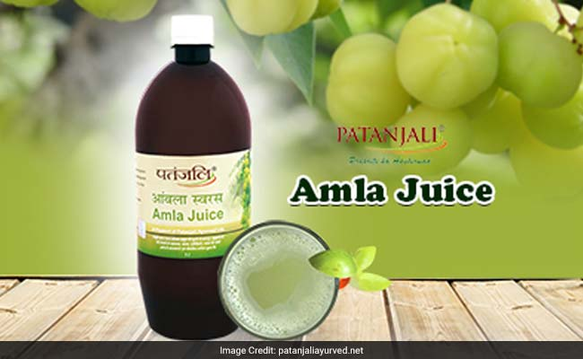
Patanjali defends Amla Juice, says it’s a medicinal product.
Patanjali says its amla juice does not fall under FSSAI standards but those of the AYUSH* ministry, after a Kolkata lab raised quality issues over its consumption
Source :- http://www.livemint.com/Companies/KWfFBljtKZlRQZnm9fVbaP/Patanjali-defends-amla-juice-says-its-a-medicinal-product.html April 25, 2017
*AYUSH –
Ayurveda, Yoga and Naturopathy, Unani, Siddha and Homoeopathy

Slide 75
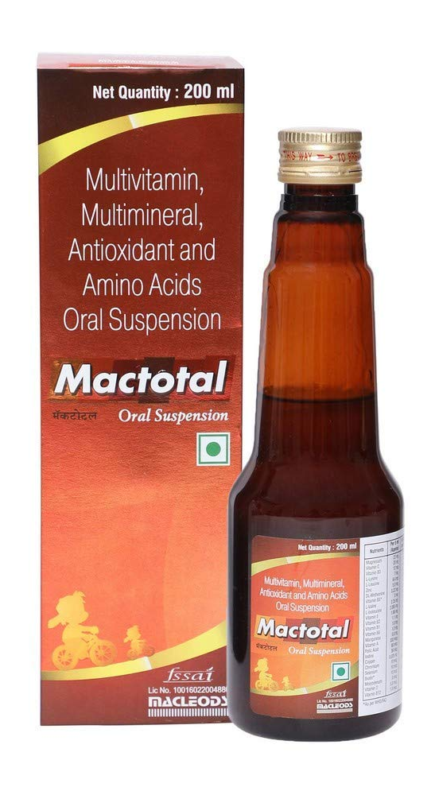

Slide 76
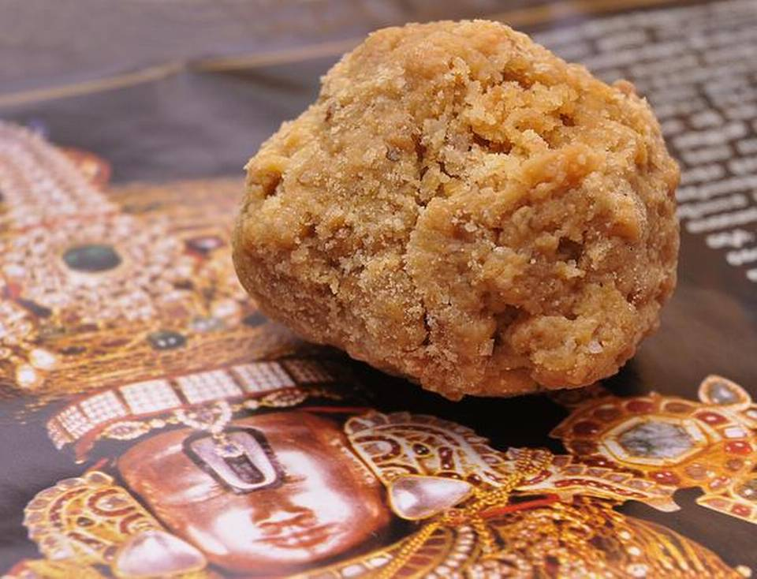
FSSAI reminds TTD about licence for ‘Laddu’
An RTI query has revealed that the Tirumala Tirupati Devasthanam (TTD) is yet to respond to letters sent a year ago by the Food Safety and Standards Authority of India (FSSAI) asking why they had not taken a food licence or allowed authorities to inspect their kitchen.
M. Kannan, Deputy Director, Central Licensing Authority, FSSAI, Southern Regional Deputy Director, who sent the letter on May 18 seeking a response from the TTD, said, “They are not cooperating with us despite sending several reminders. We cannot enter their premises by force. If they do not reply by June 15, we will take advice from the central office for necessary action.”
TTD gets food safety licence
Sept. 2017
http://www.thehindu.com/news/cities/bangalore/fssai-reminds-ttd-about-licence-for-laddu/article18868212.ece June 8, 2017

Slide 77
Recent PILs/Reports on Food Adulteration
Adulteration in milk: Madras High Court directs government to file status. PIL filed by Advocate A P Suryaprakasam seeking a CBI probe into the reports of adulteration in milk by various private producers. (Indian Express, June 5 , 2017)
The Amendments had been proposed in light of the judgment of the Supreme Court in the case of Swami Achyutanand Tirth & Ors. v. Union of India & Ors., AIR 2016 SC 3626, wherein the Court had directed the Central Government to come up with suitable amendments in the Food Act and the IPC, to bring it at par with the State amendments.
Law Commission Report No. 264, The Criminal Law (Amendment) Bill, 2017 (Provisions dealing with food adulteration)

Slide 78
Recent PILs/Reports on Food Adulteration
Earlier this year, the Law Commission of India, in its Report No. 264, had recommended life imprisonment for those convicted of manufacturing and selling adulterated food. It had, in this regard, presented the Criminal Law (Amendment) Bill, 2017, proposing to amend Sections 272 and 273 of the Indian Penal Code, and bringing it in line with the Food Act as well as the punishments prescribed by the IPC amendments made by Odisha, Uttar Pradesh and West Bengal.
Section 272 IPC – Adulteration of food or drink intended for sale
6 months imprisonment or with fine upto Rs. 1000 or with both
Section 273 IPC – Sale of noxious food or drink
6 months imprisonment or with fine upto Rs. 1000 or with both

Slide 79
Year 2012-13
Top 5 in terms of sample taken
Name of State/UT | Total sample taken | Sample Analyzed | No of samples found adulterated | No of cases launched | Conviction | Penalties Raised | Food Safety Officer
A | B | C | D | E | F | G | H
UP | $ | 11086 | 2927(26%) | 2551 | $ | 37096600 | $
Gujarat | $ | 11047 | 881(8%) | 46 | $ | 97500 | $
Rajasthan | $ | 10236 | 186(2%) | $ | $ | 295 | $
MP | $ | 8101 | 2043(25%) | 1183 | $ | 844 | $
Maharashtra | $ | 7800 | 757(10%) | 114 | $ | 8299485 | $
Punjab | $ | 4782 | 553(12%) | 304 | $ | 92 | $
Overall | $ | 69,949 | 10,380 | 5,840 | $ | 5,24,95,016 | $
$ Details not available in report.

Slide 80
Year 2013-14
Top 5 in terms of sample taken
Name of State/UT | Total sample taken | Sample Analyzed | No of samples found adulterated | No of cases launched | Conviction | Penalties Raised | Food Safety Officer*
A | B | C | D | E | F | G | H
UP | 11579 | 13554 | 4275(32%) | 2930 | 409 | 44784400 | -
Gujarat | 11111 | 10495 | 900(9%) | 397 | 16 | 190000 | -
Maharashtra | 7677 | 7516 | 1523(20%) | 1172 | 1434 | 4176500 | -
Rajasthan | 6375 | 6375 | 1160(18%) | 436 | - | 1550000 | -
Punjab | 6227 | 5884 | 771(13%) | 203 | 3 | 77 | -
MP | 4743 | 4599 | 1433(31%) | 836 | 3 | 2932000 | -
Andhra Pradesh | 4038 | 4038 | 716(18%) | 671 | - | 3994385 | -
Overall | 72,994 | 72,200 | 13,571 | 10,235 | 9,13 | 7,34,45947 | -
*No details available in report

Slide 81
Year 2014-15
Top 5 in terms of sample taken
Name of State/UT | Total sample taken | Sample Analyzed | No of samples found adulterated | No of cases launched | Conviction | Penalties Raised | Food Safety Officer
A | B | C | D | E | F | G | H
UP | 14173 | 9605 | 4119(43%) | 3650 | 186 | 59808106 | 229
MP | 9532 | 9131 | 1412 (15%) | 843 | 418 | 4328000 | 179
Maharashtra | 8663 | 6985 | 1162 (17%) | 2295 | 75 | 16541499 | 298
Gujarat | 5638 | 5471 | 522 (10%) | 88 | 26 | 2093500 | 210
Punjab | 4124 | 3949 | 577 (15%) | 220 | 161 | 24 | 45
Overall | 68,197 | 60,548 | 12,077 | 9,230 | 1,355 | 10,64,03,414 | -
Note :- Tamil Nadu – 503 FSO, 2939 Samples taken

Slide 82
Year 2015-16
Top 5 in terms of sample taken
Name of State/UT | Total sample taken | Sample Analyzed | No of samples found adulterated | No of cases launched | Conviction | Penalties Raised | Food Safety Officer
A | B | C | D | E | F | G | H
UP | 17726 | 14833 | 7189(48% ) | 5370 | 164 | 115120480 | 695
Gujarat | 15115 | 14891 | 1242(8%) | 537 | 1 | 19005906 | 259
MP | 10035 | 9994 | 1311(13% ) | 961 | 36 | 44826000 | 182
Maharashtra* | * | * | * | * | * | * | 298
Punjab* | * | * | * | * | * | * | 46
Overall | 70,310 | 65,057 | 14,179 | 9,745 | 1,05,520 | 21,01,98,436 | -
*Report awaited
Note :- Tamil Nadu – 584 FSO, 1742 Samples taken

Slide 83
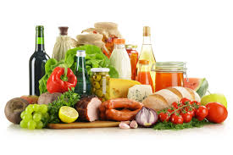
Happy Eating
Dr. Kalpeshkumar L Gupta
www.klgupta.in

